Slide 1
IBM Edge Application Manager tutorial with ML Model Updates

Slide 2
Technical Architecture Overview
Tech preview
OCP
Postgres
Mongo
Postgres
Device
Registrations
message security keys
UI
Exchange
CSS
Agbot
SDO
API
API
API
API
Edge Management Hub
message security (*)
Edge components are Blue/Light Blue
Edge Management Hub Components are
Docker containers
Deployed in a Kubernetes cluster
Each has multiple instances
Cross Component communication is through APIs
All remote communication (arrows) is via HTTPS
All remote communication is authenticated via basic auth
Remote communication is not bidirectional
(*) Message security is additional message protection on top of HTTPS
Combination of symmetric and RSA key pair encryption
Agents and Agbots exchange messages via the Exchange API, never directly.
There are thousands of Edge Nodes
message security (*)
root protected file system
local object database
message security keys
ESS
Agent
Edge Node

Slide 3
Agent and Service Deployment (Device)
Edge Management Hub
Device
Edge agent
Node Policy (properties)
key: value, key: value, key: value
Edge Service1
Service Definition
Deployment Policy
Edge Service1
Edge Service1

Slide 4
Agent and Service Deployment (Edge Cluster)
Edge Cluster
k8s worker
Edge Management Hub
Node Policy
Edge agent
Kube Master
k8s worker
deploy
Cluster Service1
Operator for service1
Service Definition
Deployment Policy
deploy
k8s worker
Cluster Service1

Slide 5
Service Placement
The placement engine runs in the Agbot.
Continually searches for nodes that are compatible with existing deployment policies.
Continually searches for deployed services that have model policy which is compatible with the node where the service is running.
Deployment policy is logically ‘AND’ed with service policy to form the full set of policy definitions.
Service policy is optional, specified by the service author.
Compatibility is bidirectional:
the node policy satisfies the combined deployment policy
The combined deployment policy satisfies the node policy
Service Definition
Deploy service
Deployment policy
Service Policy
Node Policy
yes
+
compatible
with
no
Skip service
Placement Engine
foreach
search
search
Deploy model
Model policy
Deployed Service
Node Policy
yes
+
compatible
with
no
Skip model

Slide 6
Policy Concepts
1..1
Service Definition
1..n
1..n
In English:
A policy definition is composed of 0 or more properties, and 0 or more constraints.
A Property has name, type (optional), and value.
A Constraint has zero or more property expressions.
A node, service, deployment and model policy each have 1 policy definition.
A service definition and a service policy are independent entities with a 1..1 relationship.
A deployment policy and a model policy are independent entities that each refer to a service definition.
A deployment policy may refer to more than 1 version of a service to denote service rollback instructions.
A model policy may refer to more than 1 service definition, for each service the model is going to be deployed with.
1..1
Node Policy
Service Policy
Deployment Policy
Model Policy
1
1
1
1
Policy Definition
0..n
0..n
Property
-name: string
-value: string, int, float, boolean, …
-type: optional string
Constraint
0..n
Property expression form:
<property-name> <comparison-operator> <property-value> [<boolean-operator>] …
Parentheses may be used to provide precedence order.
Comparison operator depends on property type.
PropertyExpression

Slide 7
MMS
Only supported for edge devices
CSS
Exchange
Model
Service Definition
Model Policy
Service Policy
Model policy refers to the service(s) that the model is associated with.
Model objects are deployed where the service(s) is running.
Model policy can subset the deployment targets by using a policy constraint.
Service implementations use the ESS API (hosted by the agent) to poll for model objects.
Model objects are downloaded by the agent BEFORE the target service is told that there is a model.
Model deployment via policy enables model isolation by service. Only the service(s) associated with a model object have visibility to the model object.
Deployment Policy
Node
Node
Node Policy
ESS
Edge Service1
Model
Model

Slide 8
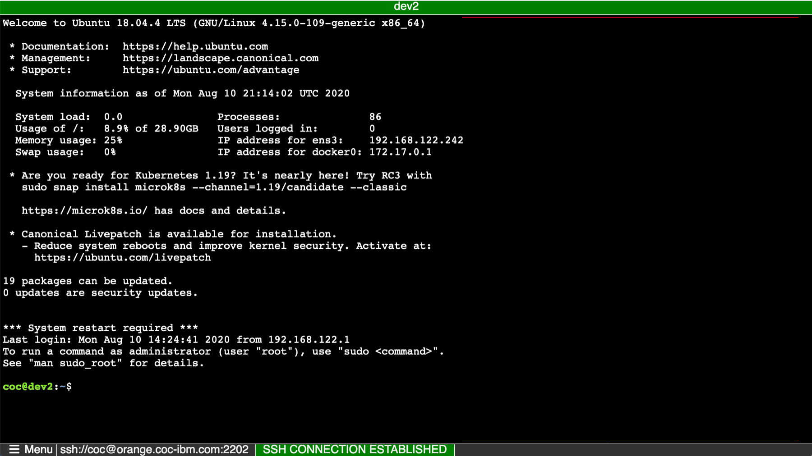
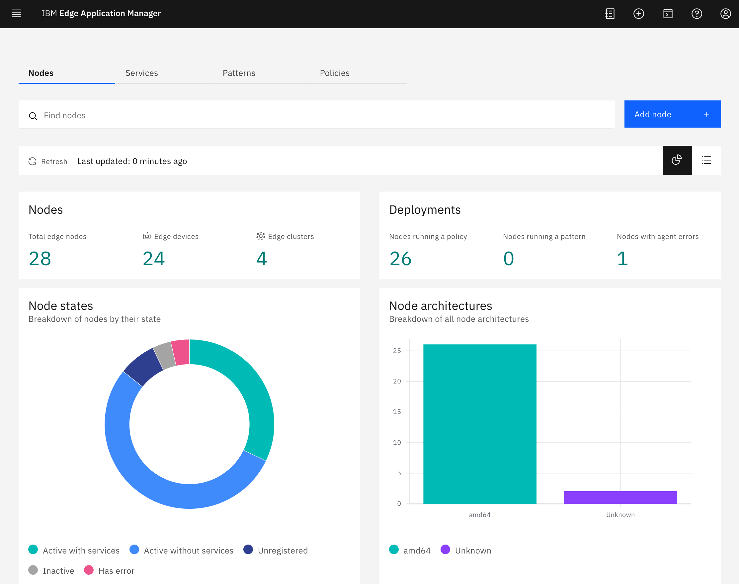





Lab Setup
Hub
Device
hzn
cloudctl
ssh
https

Slide 9
Lab Overview
This lab highlights the deployment of a model to an edge device. The sample app is a simple image analysis app using TensorFlow JS. The basic steps in this lab are:
Install agent on edge device ( virtual device in this lab )
Build and Publish an edge service
Publish a policy
Register the edge device
Validate the deployment of the model to the edge device.
Update Model
Verify change in app

Slide 10

1. Install Agent
Edge Management Hub
Device
Edge agent

Slide 11
2. Build, Publish Service
Edge Management Hub
Device
Edge agent
Service Definition
app
hzn
Docker Hub

Slide 12
3. Publish Policy
Edge Management Hub
Device
Edge agent
Service Definition
Deployment Policy
hzn
Docker Hub

Slide 13
4. Register Device
Edge Management Hub
Device
Edge agent
Node Policy (properties)
key: value, key: value, key: value
Service Definition
Deployment Policy
register
hzn
Docker Hub

Slide 14
Service (App) gets deployed to device
Edge Management Hub
Device
Edge agent
Node Policy (properties)
key: value, key: value, key: value
App
deploy
Service Definition
Deployment Policy
hzn
Docker Hub

Slide 15

5. Validate App
Edge Management Hub
Device
Edge agent
Node Policy (properties)
key: value, key: value, key: value
App
Service Definition
Deployment Policy
hzn
Docker Hub

Slide 16
6. Update Model
Edge Management Hub
Device
Edge agent
Node Policy (properties)
key: value, key: value, key: value
App
Service Definition
Deployment Policy
hzn
publish
model2
Docker Hub

Slide 17
Application sees new model and pulls it
Edge Management Hub
Device
Edge agent
Node Policy (properties)
key: value, key: value, key: value
App
Service Definition
Deployment Policy
hzn
model2
Docker Hub

Slide 18
5. Verify updated model
Edge Management Hub
Device
Edge agent
Node Policy (properties)
key: value, key: value, key: value
App
Service Definition
Deployment Policy
hzn
model2
Docker Hub

Slide 19
Edge device userid/password:
green/green
Edge device hostname and ssh port:
ssh green @orange.coc-ibm.com -p 2501
or you can use this web terminal
http://orange.coc-ibm.com:2322/ssh/host/orange.coc-ibm.com?port=2501&header=green
IEAM console userid/password:
green / green
IBM Console URL:
https://icp-console.apps.bb8.coc-ibm.com/edge
Cloudctl API URL:
https://icp-console.apps.bb8.coc-ibm.com
Your Docker Hub ID (you can create a temporary one if you like at https://hub.docker.com/signup)

Slide 20
Thank You

